Slide 1
Capstone Project-2 Bike Sharing Demand Prediction Submitted by Ayush shrivastava Data science Trainee , Almabetter

Slide 2
Content
Introduction
Problem statement
Data summary
Feature types
Exploratory Data Analysis (EDA)
Model Building -(Linear regression , decision Tree , random forest , Gradient boost , XGBoost )
Evaluation Matrix of all model
Model explainability – SHAP
Conclusion

Slide 3
Introduction
A bike rental system offers individuals the opportunity to use bicycles on a short-term basis, either for a fee or at no cost. Typically, these systems involve a computer-controlled dock where users can enter their payment information and unlock a bike, which can then be returned to any other dock within the same network. The bikes can be rented for various periods such as hourly, weekly, or through membership plans.

Slide 4
Problem Statement:
Currently Rental bikes are introduced in many urban cities for the enhancement of mobility comfort. It is important to make the rental bike available and accessible to the public at the right time as it lessens the waiting time. Eventually, providing the city with a stable supply of rental bikes becomes a major concern. The crucial part is the prediction of bike count required at each hour for the stable supply of rental bikes.

Slide 5
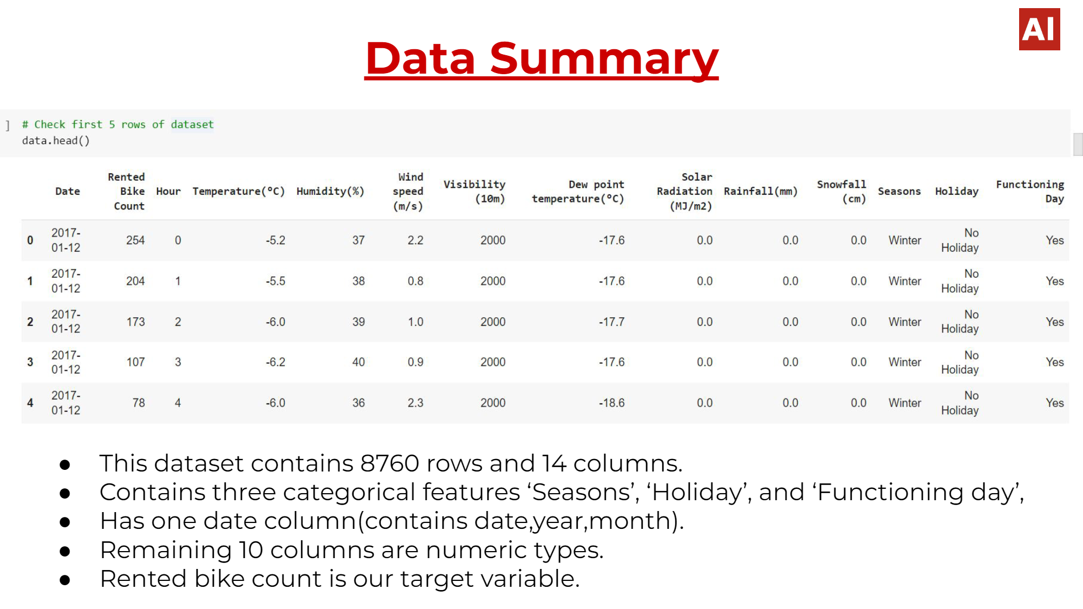

Slide 6
Feature types
Date : year-month-day
Rented Bike count - Count of bikes rented at each hour
Hour - Hour of he day
Temperature-Temperature in Celsius
Humidity - Humidityin the air in %, type: int
Wind speed (m/s) - Speed of the wind in m/s
Visibility - 10m
Dew point temperature(°C) - The temperature at which the water starts to condense out of the air,
Solar radiation - MJ/m2-Electromagnetic radiation emitted by the Sun
Rainfall - mm
Holiday - If the day is holiday or not
Seasons - Winter, Spring, Summer, Autumn
Functional Day - NoFunc(Non Functional Hours), Fun(Functional hours)
Snowfall -Amount of snowfall in cm

Slide 7
Exploratory Data Analysis

Slide 8
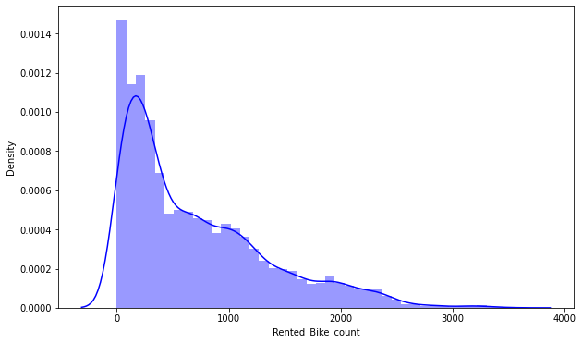
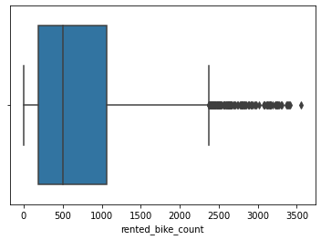
EDA (dependent variable)
The dependent variable - rented bike counts is positively skewed.
The boxplot also reveals that the column for the number of rented bikes contains many outliers.
Given that the distribution of the dependent variable must be normal for linear regression to work, the dependent variable appears to be moderately right skewed in the distribution plot shown above. As a result, we should perform some operations to make the distribution of the dependent variable normal.

Slide 9
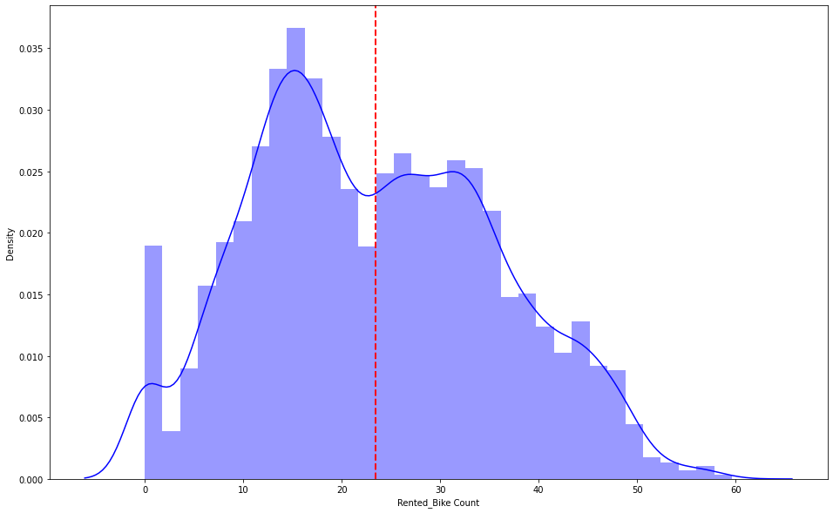
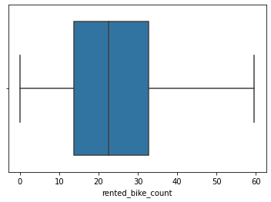
EDA (Treating the outier to get the normal dstribution)
.
Here we have applied the square root transformation to remove the outlier
We obtain an almost normal distribution after applying the square root to the skewed Rented Bike Count

Slide 10
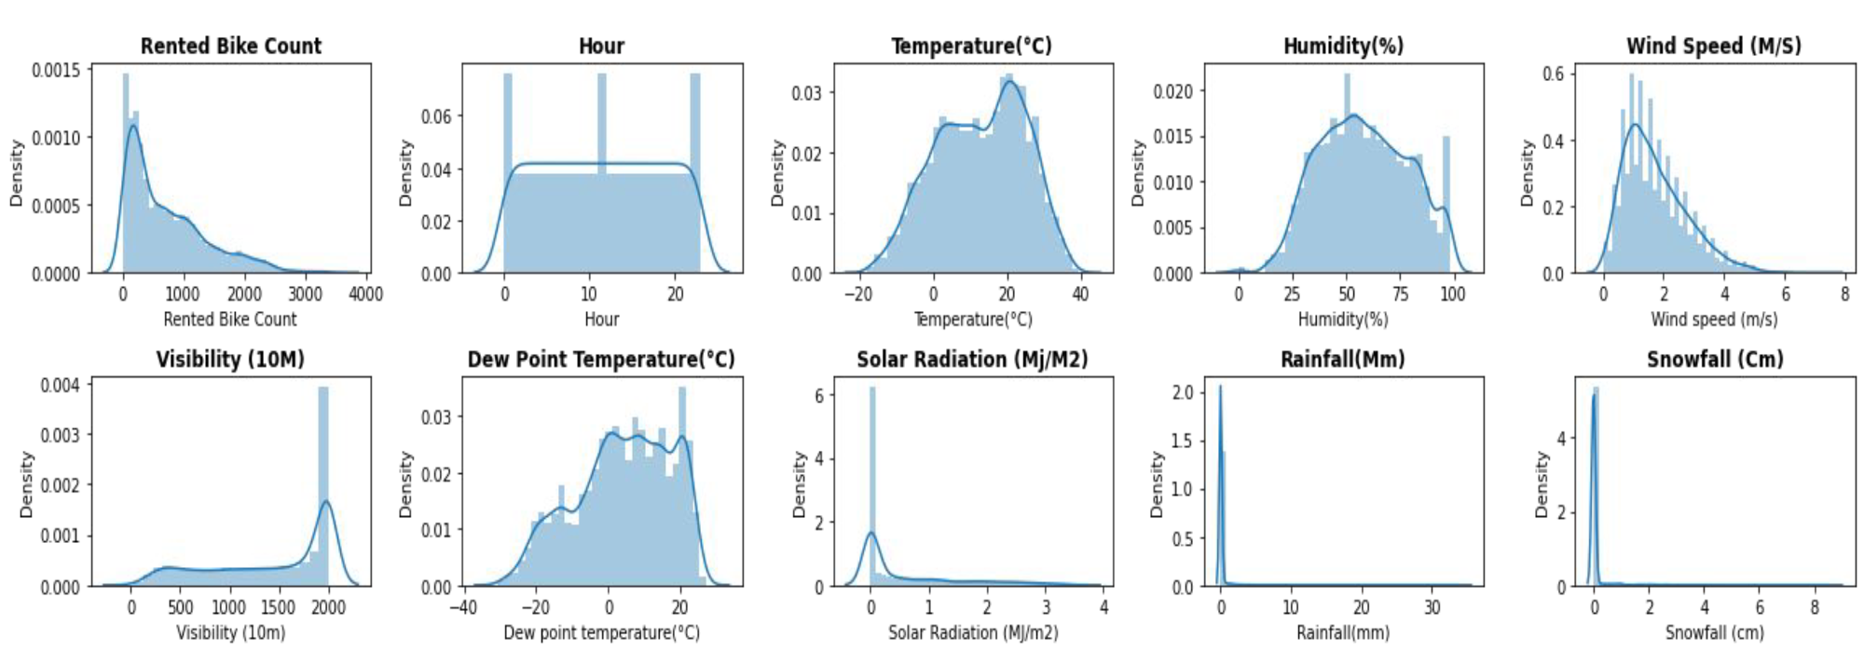
Visualising distribution of numerical features
As we can see from the above displot that Normally distributed attributes: temperature , hour , humidity. Positively skewed attributes: wind, rented bike count , solar_radiation, snowfall, rainfall. Negatively skewed attributes: visibility. ,

Slide 11
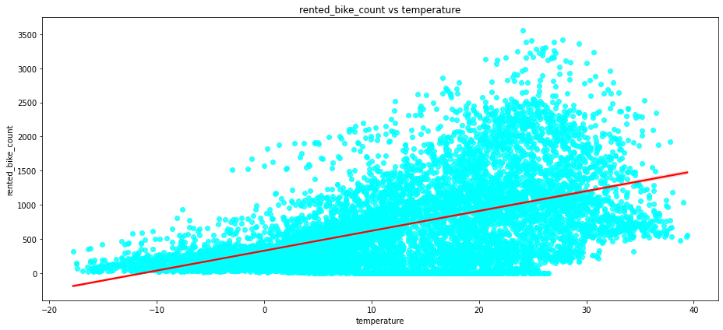
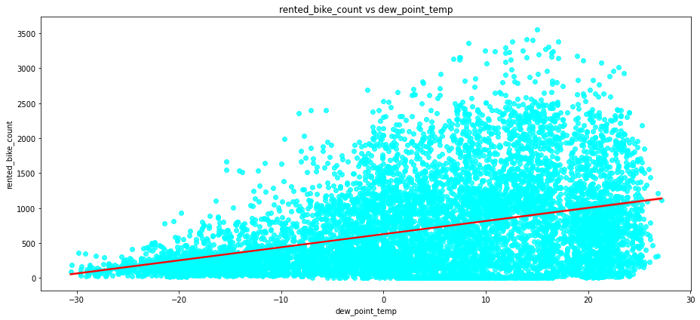
Regression plot , Numeric feature Vs rented bike count
As can be seen from the regression figure above, the columns "Temperature" and "Dew point temperature" have a positive relationship with the target variable.

Slide 12
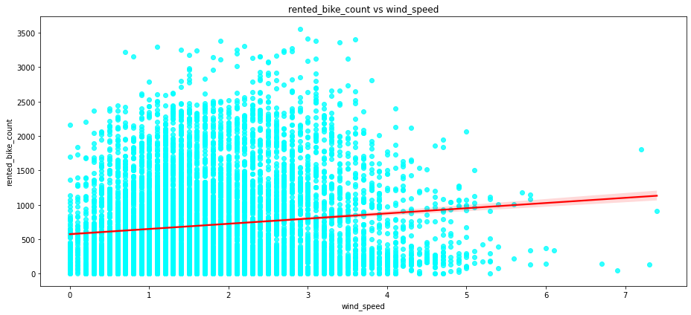
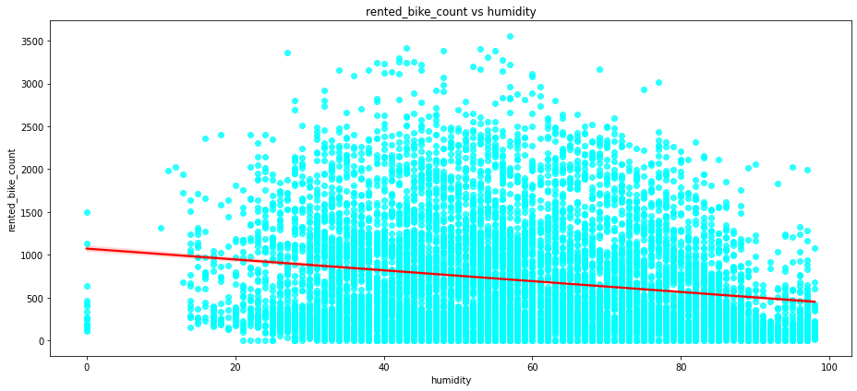
Regression plot , Numeric feature Vs rented bike count
The target variable and "Humidity" have a negative relationship, while "Wind speed" has a positive relationship. As a result, as humidity rises and vice versa, the number of rental bikes count decreases.
Light breeze is defined as a speed of 5-7 m/s.

Slide 13
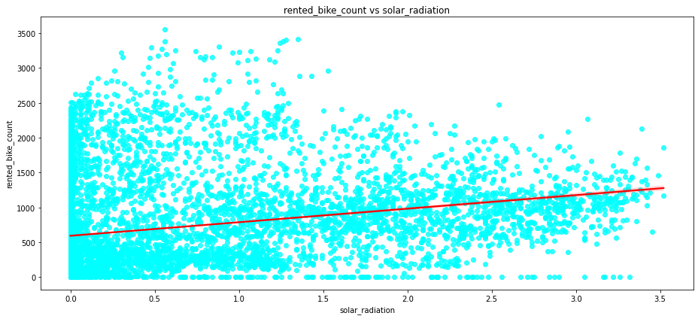
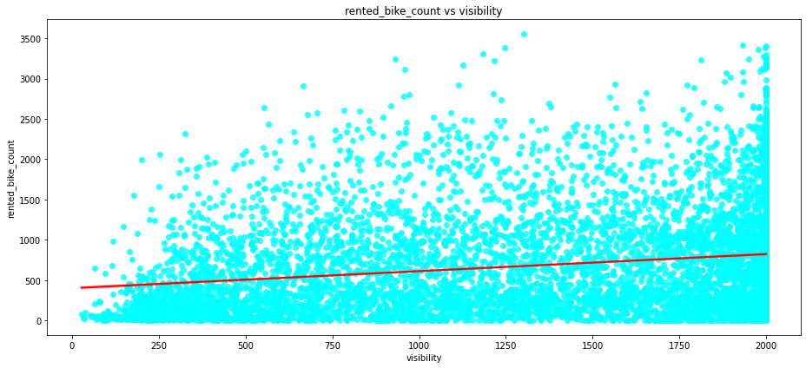
Regression plot , Numeric feature Vs rented bike count
We can observe that the columns "Visibility" and "Solar Radiation" have a positive relationship to the target variable from the preceding regression plot of all numerical features.

Slide 14
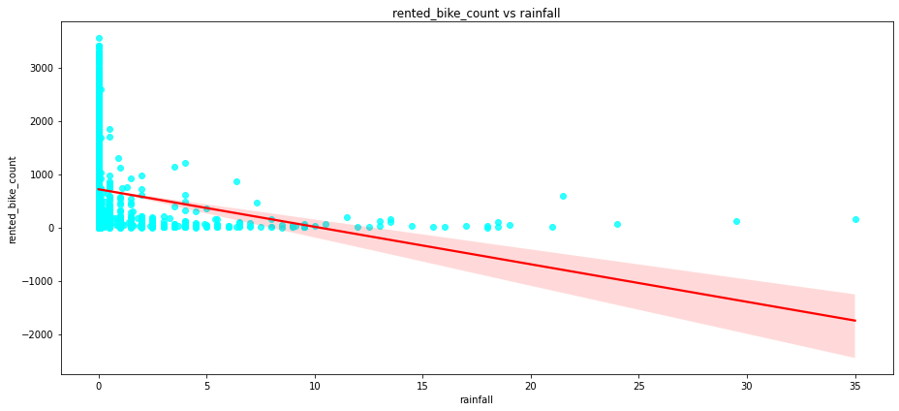
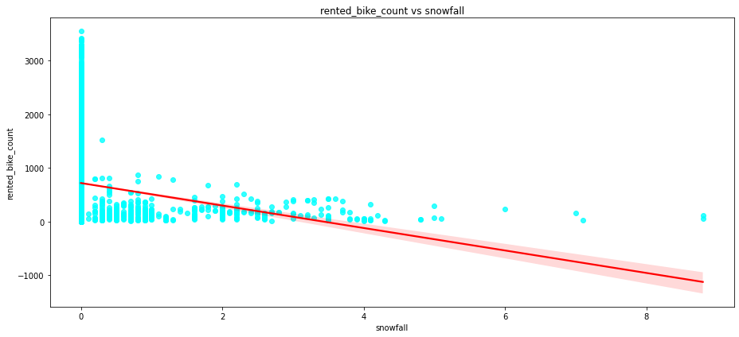
Regression plot , Numeric feature Vs rented bike count
"The target variable, (rented bike count), exhibits a negative correlation with the features of 'Rainfall' and 'Snowfall', indicating that an increase in these features is associated with a decrease in the rented bike count."

Slide 15
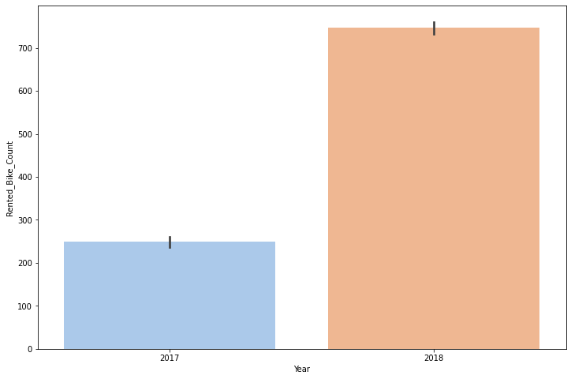
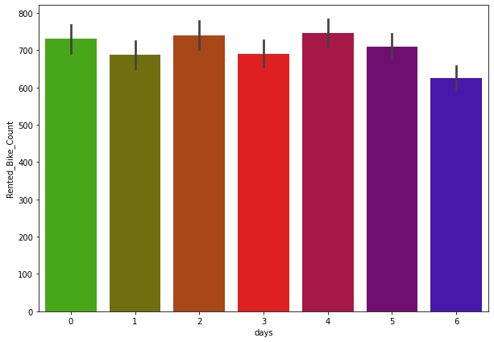
Year Vs rented_bike_count days Vs rented_bike_count
Categorical Visualization
Our collection primarily includes data from the year 2018 and only a little amount from the year 2017.
As we can see from the above graph the , all days, rented bike count is consistant and equal

Slide 16
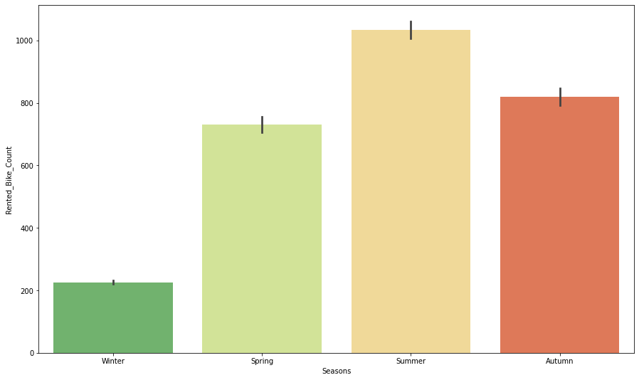
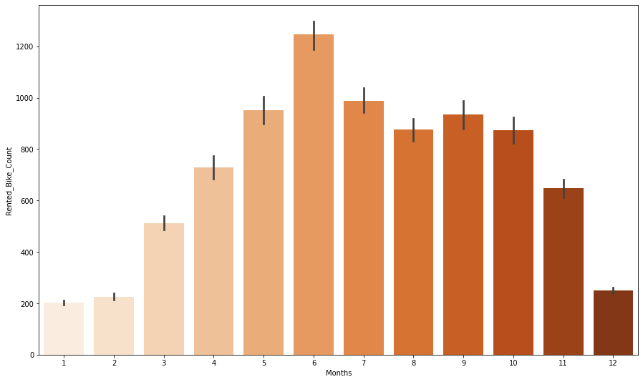
Season Vs rented_bike_count Month Vs rented_bike_count
As we can see clearly from the above bar graph, We have found that average of the rented bike counts is higher during the summer and lowest during the winter. And it is evident that people enjoy riding bicycles in the summer and the autumn.
We can observe that the months of December, January, and February—the winter seasons—have lower demand for rented bikes than those months, as well as May, June, and July—the summer seasons—which have the highest demand for bikes.

Slide 17
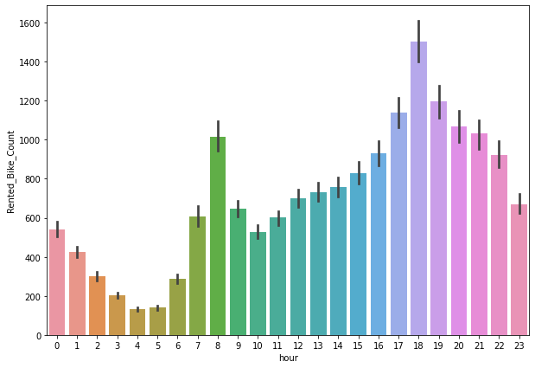
Hour Vs rented_bike_count
People favour rented bikes during rush hour, as evidenced by the high surge in hired bikes from 8:00 am to 9:00 pm. We may state that during business opening and closing times there is a significantly high demand because it is apparent that demand increases most at 8 a.m. and 6:00 p.m.

Slide 18
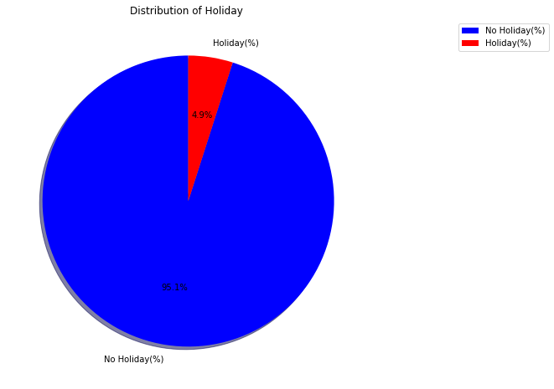
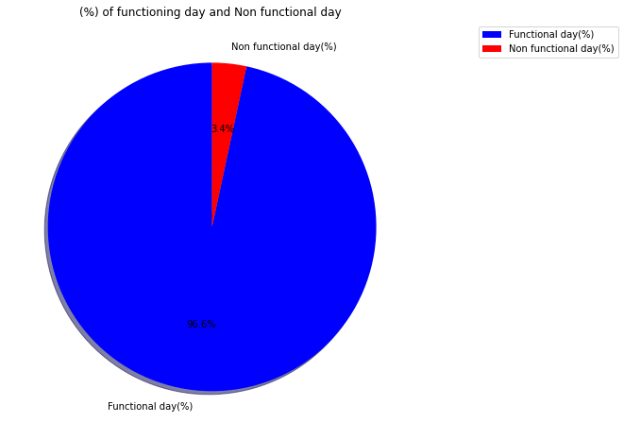
Holiday , No holiday Functional day, non functional day
Bike Renting trend on holiday and functional days
People prefer bikes to rent on no-holiday as compared to holiday
it can be observed that 96.6% of the dataset consists of non-functional days, while the remaining 3.4% represents weekends. This indicates that there is a significantly higher demand for bikes on functional days compared to non functional days, where the demand is relatively low.

Slide 19
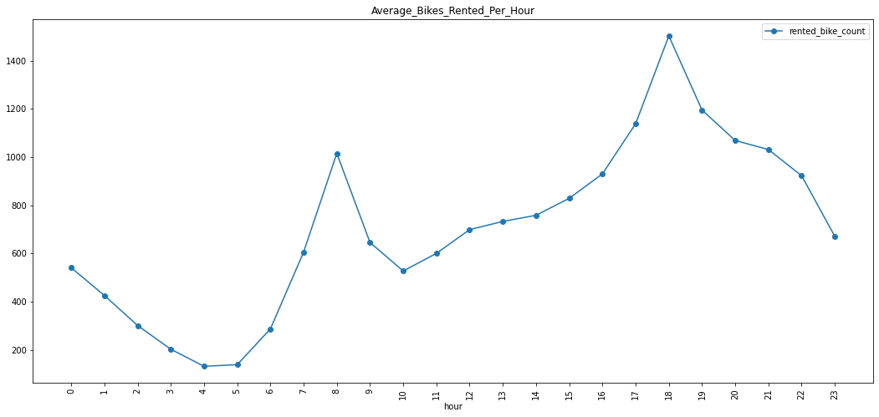
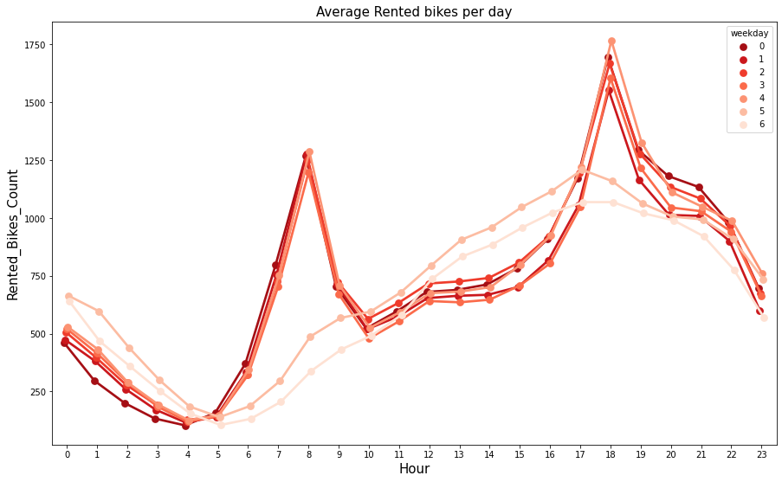
Avg rented bike per hour and Avg rented bikes per day based on hour
By observing the graph, it is clear that there is a sharp increase in the use of rented bikes between the hours of 8:00 a.m. and 9:00 p.m.
suggesting that individuals prefer to use rented bikes during peak hours.
By analyzing the Graph, it can be concluded that the average number of rented bikes remains relatively stable from Monday to Saturday. However, there is a noticeable dip in bike rentals on Sundays

Slide 20
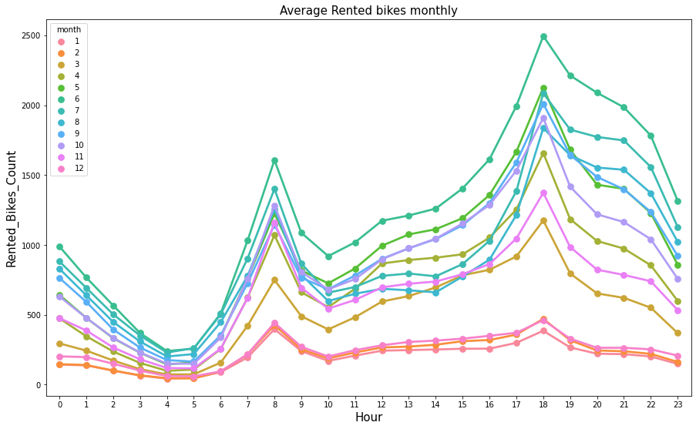
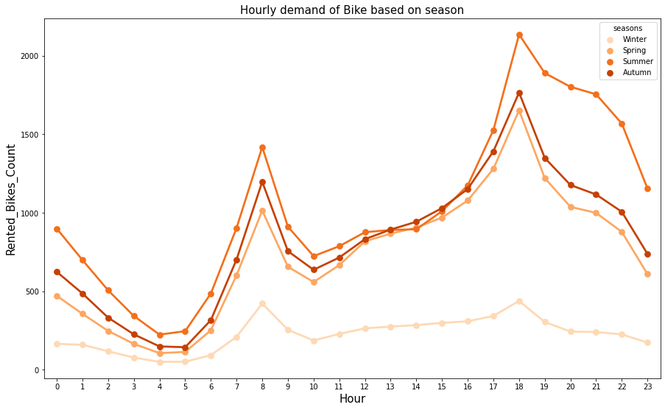
The analysis of the graph reveals that the demand for rented bikes is lower during the winter months, specifically December, January, and February, in contrast to the summer months of May, June, and July, which exhibit the highest demand. The graph indicates a significant surge in rented bike usage between 8:00 a.m. and 9:00 p.m.,
Amazingly, it has been shown that during certain seasons, consumers prefer to rent bikes more frequently. Summer is the season with the most and winter is least number of rented bikes.

Slide 21
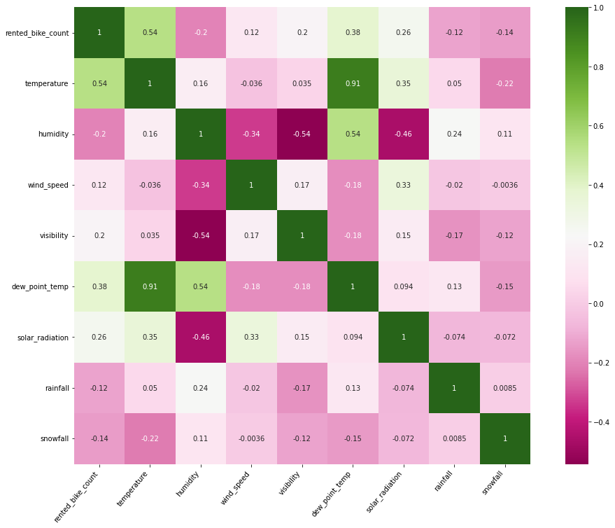
Correlation Heatmap
The temperature(°C) and dew point temperature(°C) columns of this graph demonstrate multicollinearity, as can be seen.
We don’t want multicollinearity in our data as it affects the performance metrics that’s why we have to drop dew point temperature

Slide 22
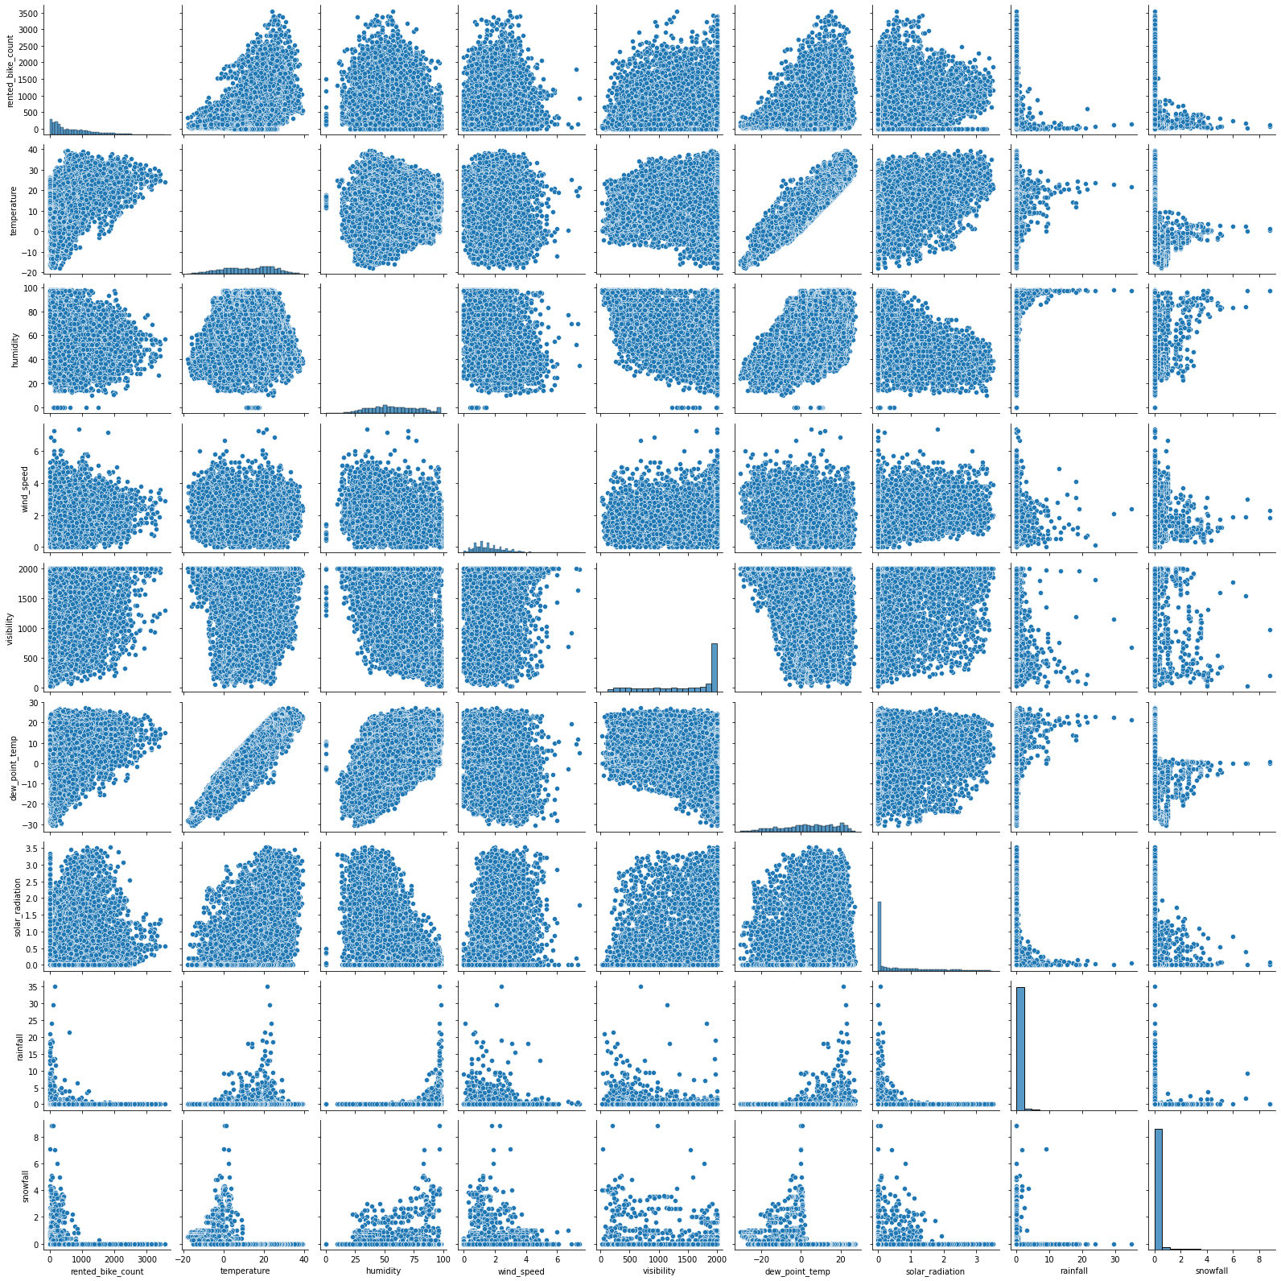
Pairplot
The above graph showed less linear correlations between variables and non-linear separability of data points, which was new to me. Hence, we may conclude that both positive and negative trends are present in the relationship between each column in the graph.

Slide 23
Model Building :
Linear Regression model
Ridge regression
Lasso regression
Elastic Net
Decision Tree regression model
Decision Tree
Random forest
GradientBoostingRegressor
XG Boost model

Slide 24
LR
Linear regression
Ridge
DT
Decision Tree
RF
Random Forest
Lasso
ElasticNet
GB
XGB
Models
Gradient boost
XGBoost

Slide 25
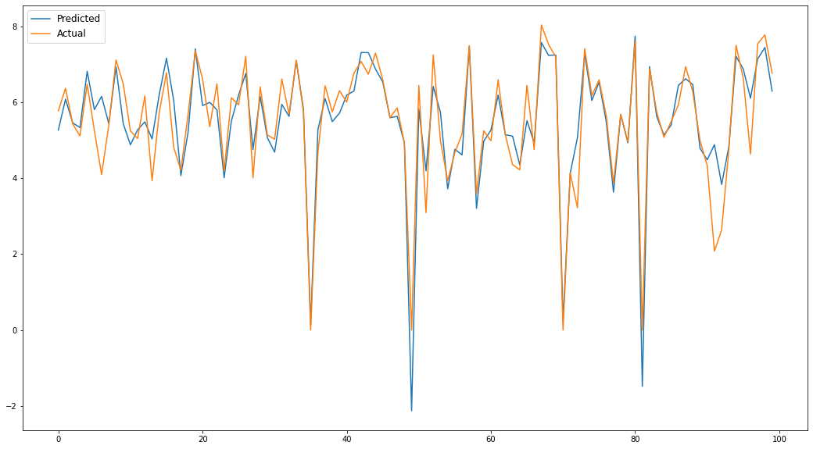
Linear regression
Evaluation metrics:
MAE on train set: 0.440
MAE on test set: 0.432
MSE on train set: 0.416
MSE on test set: 0.405
RMSE on train set: 0.645
RMSE on test set: 0.636
R2 on train set: 0.8298872959005922
R2 on test set: 0.8488235468863612
Adjusted R2 on train is :0.8241633147118872
Adjusted R2 on test is : 0.8437367358902116

Slide 26
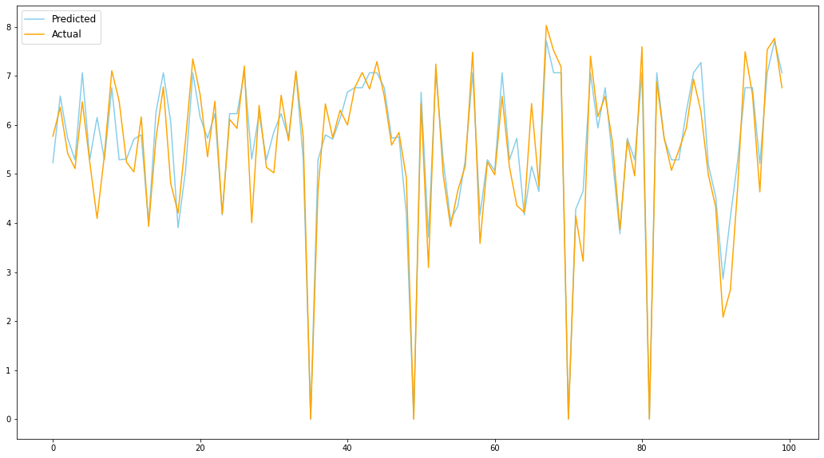
Decision Tree
Evaluation metrics:
MAE on train set: 0.368
MAE on test set: 0.402
MSE on train set: 0.272
MSE on test set: 0.364
RMSE on train set: 0.521
RMSE on test set: 0.603
R2 on train set: 0.8889753224262243
R2 on test set: 0.8641758317815932
Adjusted R2 on train 0.8852395451997159
Adjusted R2 on test is : 0.859605597077668
Parameters :
{'max_depth': 10, 'min_samples_leaf': 6, 'min_samples_split': 3}

Slide 27
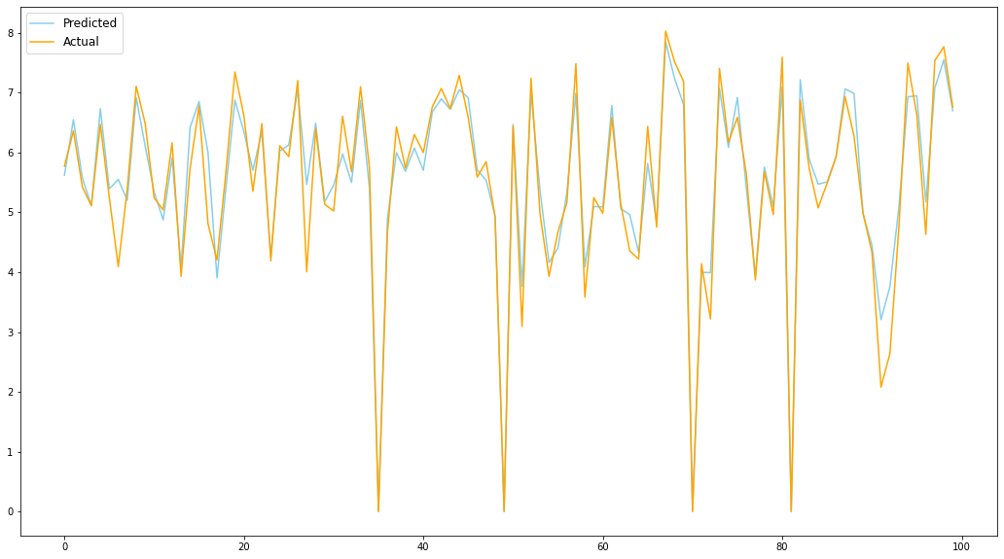
Random forest Regressor
Evaluation metrics:
MAE on train set: 0.159
MAE on test set: 0.275
MSE on train set: 0.057
MSE on test set: 0.209
RMSE on train set: 0.239
RMSE on test set: 0.457
R2 on train set: 0.9767283564314638
R2 on test set: 0.9221084429782838
Adjusted R2 on train is : 0.9759453082122156
Adjusted R2 on test is : 0.9194875346251328
Parameters : {'n_estimators': 100, 'min_samples_leaf': 1, 'max_depth': 19}

Slide 28
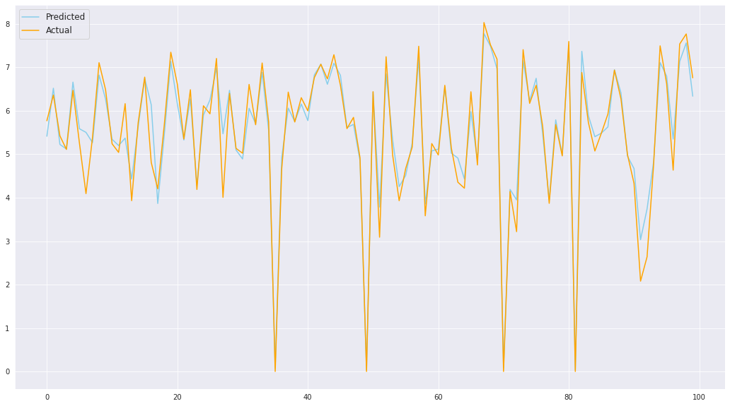
GradientBoostingRegressor
Evaluation metrics
MAE on train set: 0.147
MAE on test set: 0.260
MSE on train set: 0.045
MSE on test set: 0.195
RMSE on train set: 0.211
RMSE on test set: 0.441
R2 on train set: 0.9817521187026687
R2 on test set: 0.9273355088408269
Adjusted R2 on train is : 0.9811381108904208
Adjusted R2 on test is : 0.9248904816884816
Parameters :
{'n_estimators': 50, 'max_depth': 10,
'learning_rate': 0.1}

Slide 29
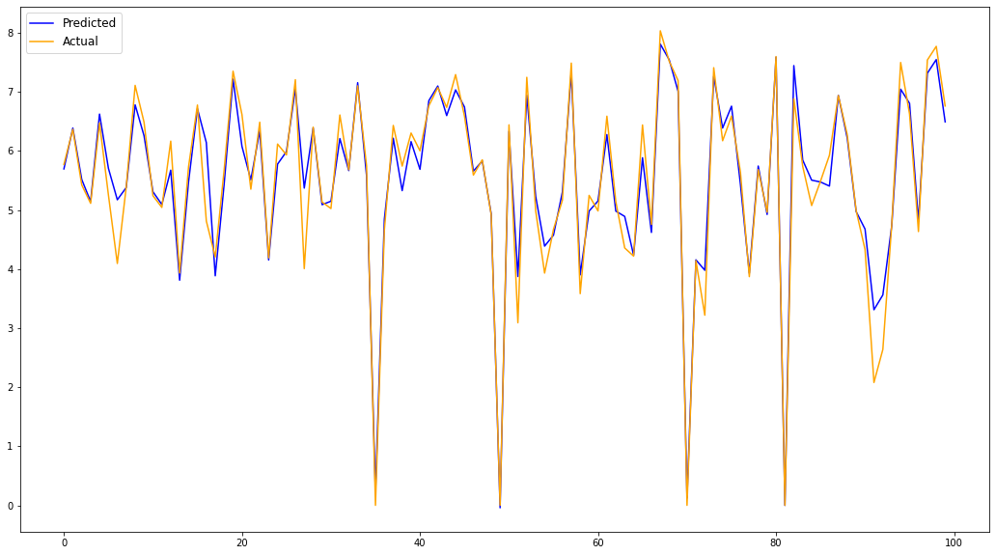
XGboost (Extreme Gradient Boost)
Evaluation metrics :
MAE on train set: 0.146
MAE on test set: 0.244
MSE on train set: 0.049
MSE on test set: 0.172
RMSE on train set: 0.222
RMSE on test set: 0.414
R2 on train set:
0.9799451580850529
R2 on test set:
0.9359259356062737
Adjusted R2 on train is :
0.9792703493547389
Adjusted R2 on test is :
0.9337699605942061
Parameters :
{'learning_rate': 0.1, 'max_depth': 8}

Slide 30
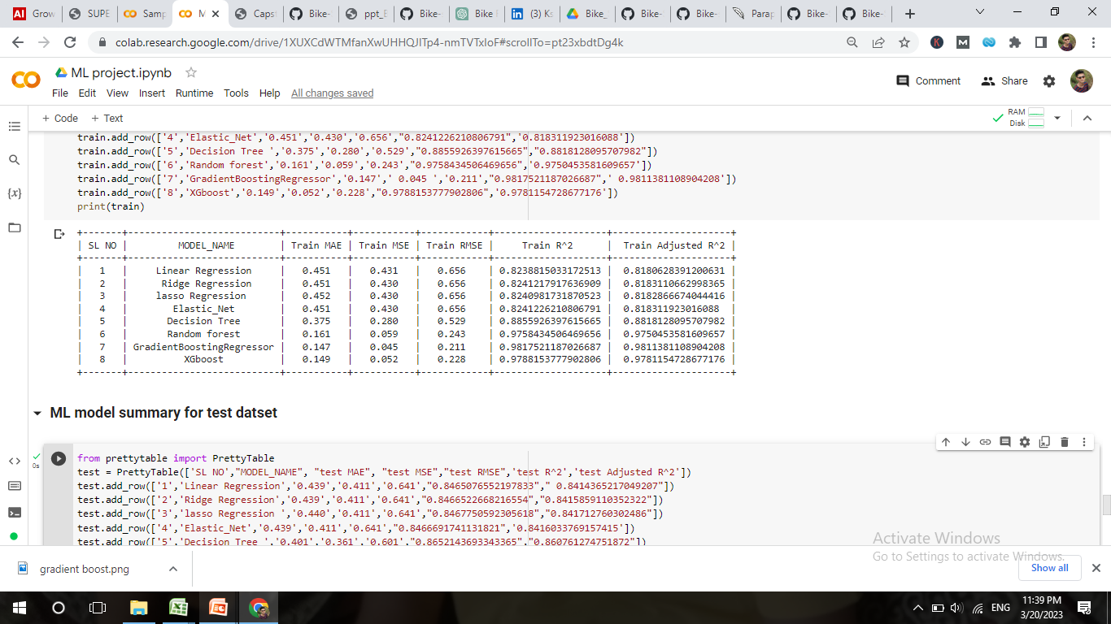
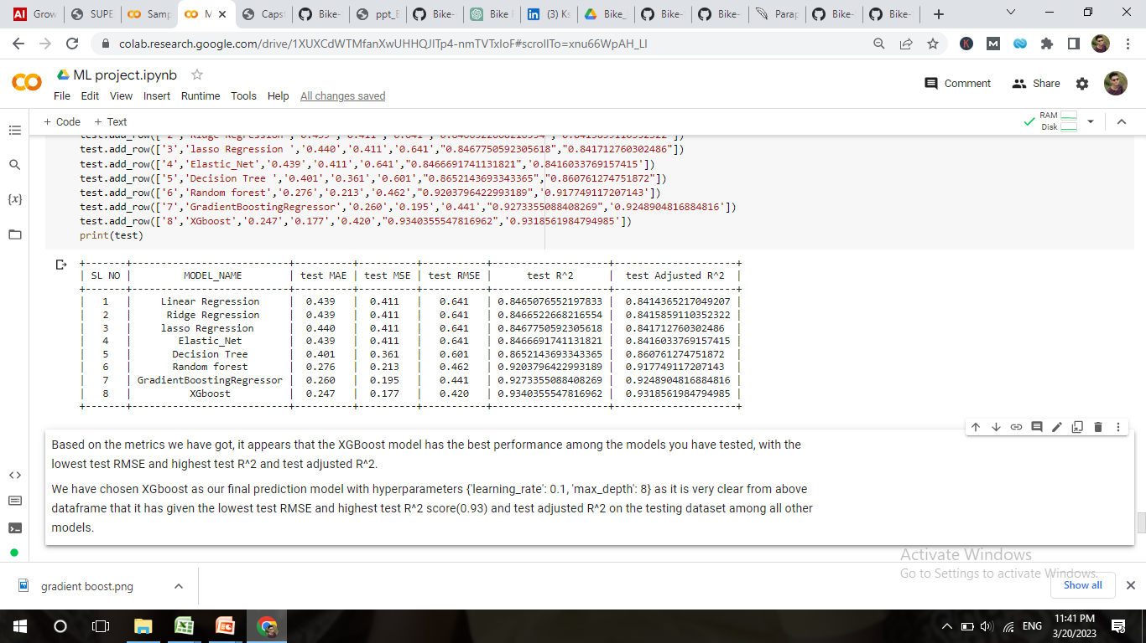
Models Evaluation metrics
Evaluation metrics of Train dataset
Evaluation metrics of Test dataset

Slide 31
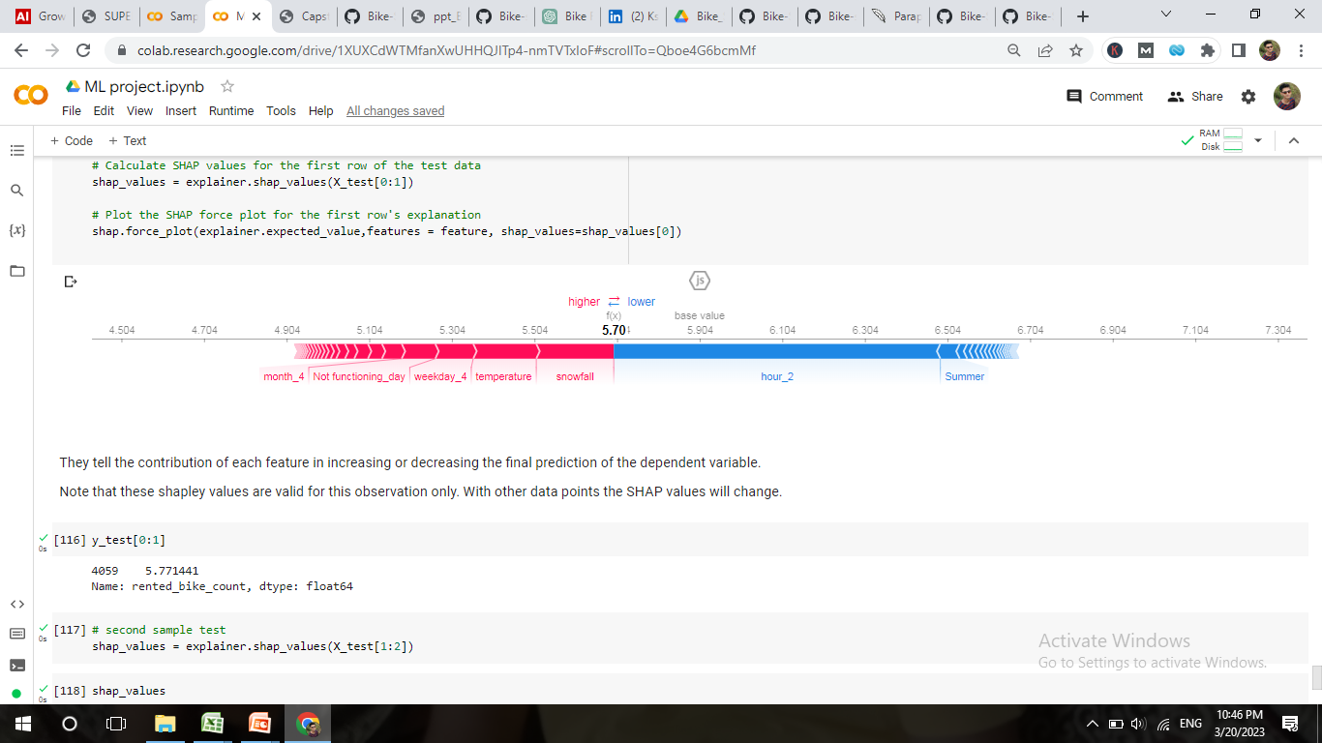
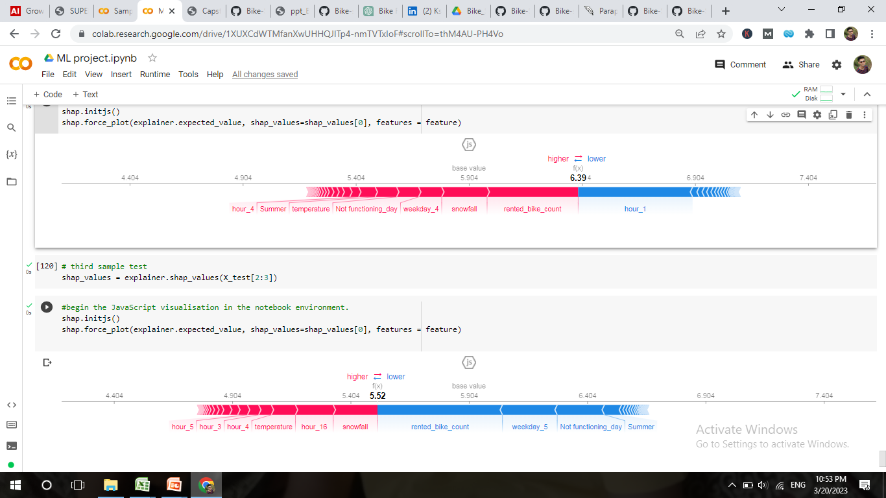
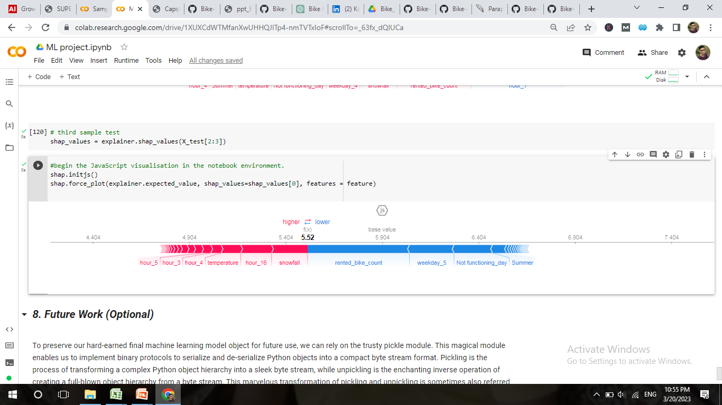
Models explainability using SHAP (Shapley Additive exPlanations)
They tell the contribution of each feature in increasing or decreasing the final prediction of the dependent variable.

Slide 32
EDA Conclusion
As we can see from the graph that Normally distributed attributes: temperature , hour , humidity. Positively skewed attributes: wind, rented bike count , solar_radiation, snowfall, rainfall. Negatively skewed attributes: visibility.
Hour, Temperature, Wind Speed, Visibility, and Solar Radiation are all positively correlated with the dependant variable. This implies that the number of rented bikes rises as these features do, while the columns "Rainfall," "Snowfall," and "Humidity" are those features that have a negative relationship with the dependent variable, suggesting that the number of rented bikes falls as these features rise.
Our collection primarily includes data from the year 2018 and only a little amount from the year 2017.
We can observe that the months of December, January, and February—the winter seasons—have lower demand for rented bikes than those months, as well as May, June, and July—the summer seasons—which have the highest demand for bikes.
As we have observed that , all days, rented bike count is consistant and equal.
I am able to see the valuable insights about the distribution of the 'holiday' column in my dataset. The chart revealed that the majority of the ratings - a whopping 95.1% or 8,328 records - were on non-holiday days. In contrast, the number of ratings received during holidays was relatively low, accounting for only 4.9% or 432 records of the total rented bike count data available in the dataset. These findings highlight the importance of considering external factors, such as holidays, when analyzing data, as they can have a significant impact on the trends and patterns observed in the dataset.
People favour rented bikes during rush hour, as evidenced by the high surge in hired bikes from 8:00 am to 9:00 pm. We may state that during business opening and closing times there is a significantly high demand because it is apparent that demand increases most at 8 a.m. and 6:00 p.m.

Slide 33
People favour rented bikes during rush hour, as evidenced by the high surge in hired bikes from 8:00 am to 9:00 pm. We may state that during business opening and closing times there is a significantly high demand because it is apparent that demand increases most at 8 a.m. and 6:00 p.m.
there we have observed that 96.6% of the dataset consists of non-functional days, while the remaining 3.4% represents weekends. This indicates that there is a significantly higher demand for bikes on functional days compared to weekends, where the demand is relatively low.
We can observe a decline in demand for rented bikes when snow falls.
it can be concluded that the average number of rented bikes remains relatively stable from Monday to Saturday. However, there is a noticeable dip in bike rentals on Sundays, and on average, the number of rented bikes is significantly lower on weekends than on weekdays.
The temperature(°C) and dew point temperature(°C) columns of this graph demonstrate multicollinearity, as can be seen.
The above graph showed less linear correlations between variables and non-linear separability of data points, which was new to me. Hence, we may conclude that both positive and negative trends are present in the relationship between each column in the graph.

Slide 34
Model Conclusions
We have experimented with several regression models, beginning with Linear Regression and moving on to other non-linear models. With each model, we've carefully tuned the hyperparameters to minimize errors and ensure optimal performance.
Even after employing regularisation techniques, the model in linear regression still captures 70% of variance and has a r2 of 84%, indicating that the target variable and our data are not entirely linearly dependent on one another.
After experimenting with the Decision Tree model, we found that we achieved an impressive R-squared value of 86% accuracy with a maximum depth of 10. However, as we increased the depth beyond this point, we noticed that the model began to overfit the data. This led to a higher Mean Squared Error (MSE) of 0.361
We discovered that prioritizing individual variables when building our model did not always lead to the best accuracy. Instead, using ensemble techniques like Random Forest and optimizing hyperparameters allowed us to create a more robust and accurate model. By doing so, we achieved an impressive R-squared value of 92% with 100 trees in the forest.
while we achieved a slightly lower R-squared value of 87% using the GradientBoostingRegressor, we found that it offered the advantage of faster results due to its ability to utilize all available cores. This increased efficiency led to a reduction in processing time, making it a valuable tool for projects that require faster results.
After extensive experimentation, we ultimately settled on XGBoost as our final model. This decision was driven by the impressive results we achieved, including an R-squared value of 97% and a mean squared error (MSE) of 0.177. These results suggest that our model is highly accurate and reliable, providing us with a valuable tool for predicting outcomes and driving business growth.

